Slide 1


ANA
MACHINE LEARNING PROJECT
PREDICTING THE TOMATOMETER
Rotten Tomatoes Case: A Machine Learning Model for
Fresh vs Rotten Classification
Ana Claudia Russo & Jeronimo Cagliero
Ironhack, Data Analytics Bootcamp - Sep, 2026
Notes:
Good morning, everyone. Jeronimo and I are ready to introduce our project, Predicting the Tomatometer, based on the Rotten Tomatoes dataset.

Slide 2
ANA
01 · PROJECT OVERVIEW
THE GOAL & THE DATASET
THE GOAL
THE DATASET
🎯
GOAL
🍅
SOURCE
Predict whether a movie is Fresh or Rotten using ML, based on metadata and audience/critic signals.
Rotten Tomatoes: a website that aggregates movie ratings from critics and audiences worldwide.
🤖
ML TASK
📊
DATASET
Binary classification, trained on historical rating patterns.
rotten_tomatoes_movies.csv — title, genre, cast, runtime, audience & critics' scores (scraped Oct 2020).
💡
WHY IT MATTERS
Reveals which factors drive critical reception — valuable for studios and streaming platforms.
Notes:
Rotten Tomatoes is a popular website that collects movie ratings from both critics and audiences. For this project, we use the rotten_tomatoes_movies dataset, that is the most complete file available;
Although scraped in October 2020, it still provides strong information for building Machine Learning models.
Our project asks a simple question: can we predict whether a movie will be Fresh or Rotten? To answer that, we treat this as a binary classification task — the model learns from historical rating patterns to predict one of two outcomes.
This matters because understanding which factors drive critical reception is valuable for studios and streaming platforms, helping them make smarter marketing and content decisions.

Slide 3
ANA
02 · DATA PREPARATION
DATA SELECTION & PREPARATION
RAW DATA
FILTER · CATEGORIZE · CLUSTER
FINAL DATASET
17,712
8,934
rows × 22 columns
rows × 10 main columns
🧹
FILTER BY POPULARITY
🗂️
CATEGORIZE & CLUSTER
🎯
BINARY TARGET
Kept only movies with “audience_count” > 3,500 reviews
- AI-assisted grouping of columns with too many unique values into manageable categories;
- K-Means clustered columns by “audience_rating”, “audience_count” and “movie_count”
“tomatometer_status”
Fresh (≥60% positive) vs. Rotten (<60%).
Notes:
We started with a raw dataset of 17,712 movies and 22 columns. To keep only meaningful titles, we filtered for movies with more than 3,500 audience reviews.
Next, we simplified genre and content rating columns into a small number of clear categories, using AI-assisted grouping.
For directors, authors, actors, and production companies columns — which had too many unique values to use directly — we applied K-Means clustering, grouping them by average rating, review count, and number of movies.
Finally, we converted our target column into a binary label: Fresh, for 60% or more positive critic reviews, and Rotten for anything below that.
After all this preparation, our final dataset had 8,934 rows and 10 columns.

Slide 4
ANA
03 · FEATURE ENGINEERING
FEATURE ENGINEERING & SELECTION
ENGINEERING PROCESS
SELECTION APPROACH
Train/Test split with stratification to preserve class balance before any transformation.
One-Hot Encoding for categorical variables, with consistent dummy columns across train/test.
MinMaxScaler normalization for numerical features (e.g. runtime).
Reindexed test set to match training columns, preventing feature mismatch.
Removed non-predictive / leakage-prone columns (e.g. movie_title).
Selected features based on domain relevance: release date, runtime, content_group, main genre, and the director / author / actor / production_company clusters
Ensured all engineered features aligned with the model's expected input structure.
Notes:
Before training any model, we split our data into train and test sets, using stratification to keep the same Fresh-to-Rotten distribution in both.
All categorical columns were converted with One-Hot Encoding, and we made sure the test set always had the exact same columns as the training set, to avoid mismatches later.
For numerical features like runtime, we applied MinMaxScaler, which keeps ensemble models stable during training.
On the selection side, we removed movie_title column, since it's just an identifier. What we kept were the features that actually carry predictive signal such as release date, runtime, content group, genre, and the director, author, actor, and production-company clusters.

Slide 5
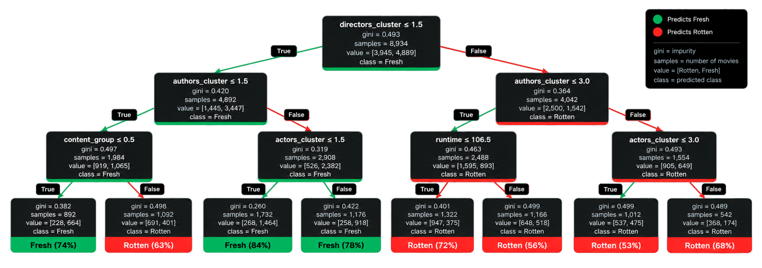
JERO
04 · FEATURE VALIDATION
decision tree - feature validation
A Decision Tree Classifier was used to validate which features best separate Fresh from Rotten movies.
🌳
Root split (directors_cluster) confirms clustering features are the strongest early predictors.
🧩
authors_cluster, actors_cluster and content_group follow — reinforcing the feature engineering choices.
🎬
Genre and runtime refine predictions within subgroups, but carry less weight than clustering.

Slide 6
JERO
05 · MODEL BUILDING
MODEL BUILDING & evaluation
We tested three models — Random Forest, XGBoost, and a manually tuned XGBoost — to compare performance and find the most effective approach.
⚠️
RANDOM FOREST
Train 83.75% → Test 73.65%. Clear overfitting; useful baseline only.
Test Accuracy by Model (%)
⚠️
XGBOOST — ORIGINAL
RandomizedSearchCV + GridSearchCV
Test 72.68%, train 80.04% — still overfitting
XGBOOST — MANUALLY TUNED
🏆
Test 74.37%, balanced precision/recall, minimal overfitting. Most reliable model.

Slide 7
JERO
05 · MODEL BUILDING
FINAL MODEL: TUNING & RESULTS
After Random Search and Grid Search still left the XGBoost overfitting (train ≈80%, test ≈73%), the model was rebuilt with manually chosen hyperparameters, favoring a simpler, more conservative configuration.
KEY HYPERPARAMETERS
TEST ACCURACY
max_depth = 3
74.37%
→ best generalization
learning_rate = 0.1, n_estimators = 300
→ stable learning
Balanced precision, recall & F1
Minimal train/test gap — no overfitting
subsample = 0.8, colsample_bytree = 0.8
→ reduced variance
reg_alpha, reg_lambda
→ controlled complexity

Slide 8
JERO
06 · KEY FINDINGS
key findings & insights
🏆
BEST OVERALL BALANCE
🛠️
TUNING WAS ESSENTIAL
The manually tuned XGBoost achieved the best balance between accuracy, stability and generalization — outperforming all other tested models.
Careful hyperparameter tuning, combining automated search with manual refinement, was essential to reach optimal performance.
📈
METADATA PREDICTS RATINGS
🔮
A FIRST STEP, NOT THE LAST
The final model shows that structured metadata (categorization / clustering) can effectively predict movie ratings.
A primary model to understand behavior; could later evolve to a regression approach, but likely needs more data.

Slide 9
ANA
07 · APPLICATION
REAL-WORLD APPLICATION & IMPACT
🎬
📊
⚖️
BUSINESS USE
DATA-DRIVEN VALUE
ETHICAL CONSIDERATIONS
Helps streaming platforms and studios predict audience reception before release, supporting smarter content acquisition and
marketing decisions.
Provides data-driven insights that reduce financial risk and improve recommendation quality across platforms.
Risk of bias reinforcement, limited understanding of creative factors, and the need for continuous updates as audience preferences evolve.
Notes:
So, what can this model actually be used for? Streaming platforms and studios could use it to anticipate how a movie will be received before it's even released, helping with marketing and content acquisition decisions.
More broadly, this kind of model gives data-driven insight that can reduce financial risk and improve recommendation quality.
But it's important to be honest about the limits. This model learns from historical patterns, so it can reinforce existing industry biases. It also doesn't understand creative factors like script quality or acting. Predictions like these should support human judgment, not replace it — and the model would need regular updates as audience tastes change.

Slide 10
ANA
08 · LEARNINGS
CHALLENGES & LEARNINGS
⚖️
NORMALIZATION
🧩
HIGH-DIMENSIONALITY
🎲
SEARCH INSTABILITY
Normalized the DataFrame for ensemble methods, ensuring consistent scaling for magnitude-sensitive algorithms.
Managed high-dimensional dummy variables while maintaining interpretability and avoiding sparse-feature issues.
Even 50+ automated tests still picked a model that overfit — more search doesn't guarantee a better model.
💧
DATA LEAKAGE
📉
OVERFITTING
Balanced preprocessing steps to avoid data leakage and ensure robust generalization.
Handled overfitting across multiple models, learning how max_depth, subsample and regularization affect generalization.
Notes:
Now to finish, a few things we learned along the way:
First, normalization — we scaled our numbers so the models could compare them fairly.
Second, high dimensionality — One-Hot Encoding created many new columns, so we had to keep the model simple and easy to understand.
Third, search instability — even after testing 50-plus combinations automatically, the best model we found still overfit. More testing doesn't always mean a better model.
Next, data leakage — we made sure no test data accidentally leaked into training.
And finally, our biggest lesson: overfitting. We saw it in every model, and it taught us how settings like max_depth and regularization affect performance on new data.

Slide 11
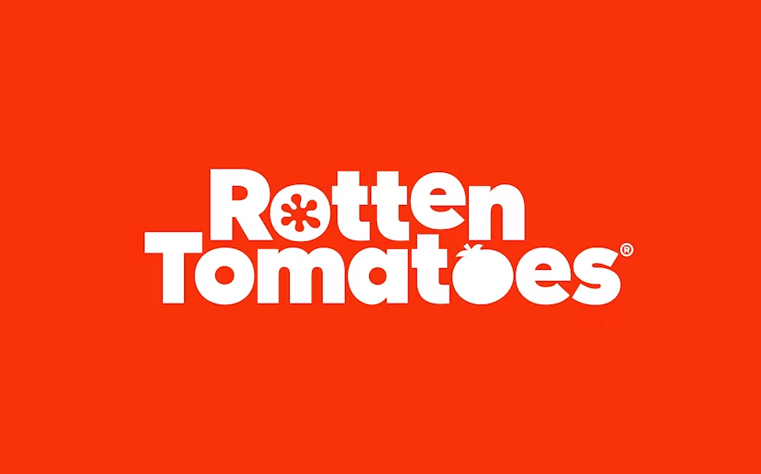
ANA
thank you!
Rotten Tomatoes: A Machine Learning Model for
Fresh vs Rotten Classification
Ana Claudia Russo & Jeronimo Cagliero
Ironhack, Data Analytics Bootcamp - Sep, 2026
Notes:
Now, Jero will share his screen to do a quick demonstration of our model predictions

